Slide 1
The Chemistry of Amino Acid Polypeptide and Protein ا د جمال احمد عبد البارى استاذ الكيمياء الحياتيه السريريه

Slide 2
Amino Acid:
Are low molecular weight compounds containing amino and carboxide group are building blocks of protein structure and determine many important protein properties.
The structural formula 20 α-Amino Acids can only be found in protein also called Standard Amino Acids.

Slide 3
All Amino Acids except Praline have free carboxyl and free amino group.

Slide 4
Biochemical Importance
1. Essential L- α -Amino Acids must be supplemental in diet which is important in the growth of a new baby (infant) and to maintain health in adult. (why?). Because it is not produced in the body.
2. Some of Hormones are Amino Acids such as Thyroid and Epinephrine.
3. Genetic defect of metabolism of Amino Acids can produce several
diseases. As in lacking a specialized enzyme for digestion of Amino acid.
4. Defect in the transport mechanism of a specific Amino Acid results in
Amino Acid urea.
5. Participate in intracellular function such as nerve transmission, and
regulation of cell growth.
6. Low molecular weight peptides play a role as hormones such as
vasopressin and Oxytocin.
Oxytocin hormone is important in induction of labor (why?). Because it is
used in muscle contraction of uterus.

Slide 5
Classification of Amino Acids
A. Classification based on polarity:
1. Non-polar R groups (hydrophobic).
2. Neutral uncharged R groups (polar R-group).
3. Positively charged R-groups.
4. Negatively charged R-groups.
All these occur at pH = 7 or 6-7. Amino Acid maybe
defined by three letters or as one letter.
All Amino Acids are soluble in water
Because they contain active groups:
Carboxylic Acid Group and Amino Group.

Slide 6
1) Non Polar R-groups:
They are (5) Amino Acids with aliphatic R-group:
Ala = Alanine, Leu = Leucine, Ile = Isoleucine,
Val = Valine, Pro = Proline
And (2) with aromatic R-group:
Phe = Phenylalanine, Try =Tryptophan.
And Met = Methionine.
The R-groups of these Amino Acids are less soluble in water Than the polar R-groups.

Slide 7
2) Uncharged Polar R-groups:
These Amino Acids are more soluble in water
include:
Ser = Serine Thr = Theronine
and Tyr = Tyrosine.
due to the presence of OH group.
Asn = Asparagine Gln = Glutamine
due to the presence of Amide.
Cys = Cysteine
due the presence of Sulfur and then Glycine.

Slide 8
3) Positively Charged (basic) R-groups:
All Amino Acids in this group have 6-carbon atoms,
they are:
Lys = Lysine, Arg = Arginine and His =Histidine.
4) Negatively Charged (acidic) R-groups:
Asp =Aspartic Acid
and Glu = Glutamic Acid.

Slide 9
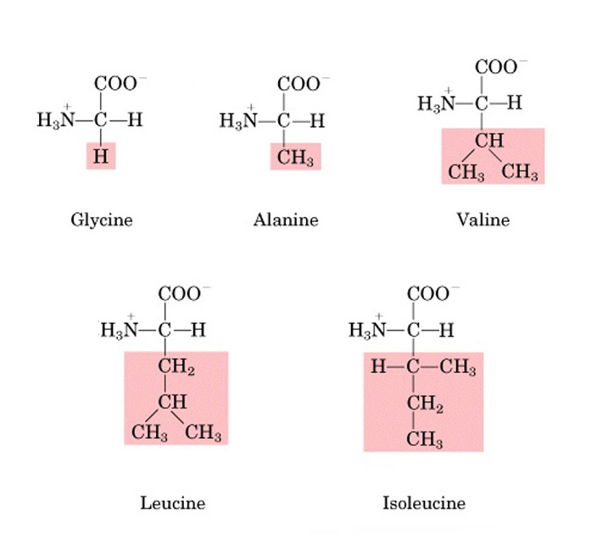
1. Aliphatic Amino Acids:
B. Amino Acids can be classified into 7 classes:

Slide 10
The Carbon atom in Glycine is a chiral.
Glycine has the most polarity. Why?
Because it's R-group does not contain a Carbon atom.

Slide 11
2. Amino Acids containing (OH)group:
Serine is more polar than Threonine (why?)
Because it contains a low number of Carbon atom.

Slide 12
3. Amino Acids containing Sulfur (S) atom:
Cysteine has higher polarity than methionine.
Methionine is less soluble in water.

Slide 13
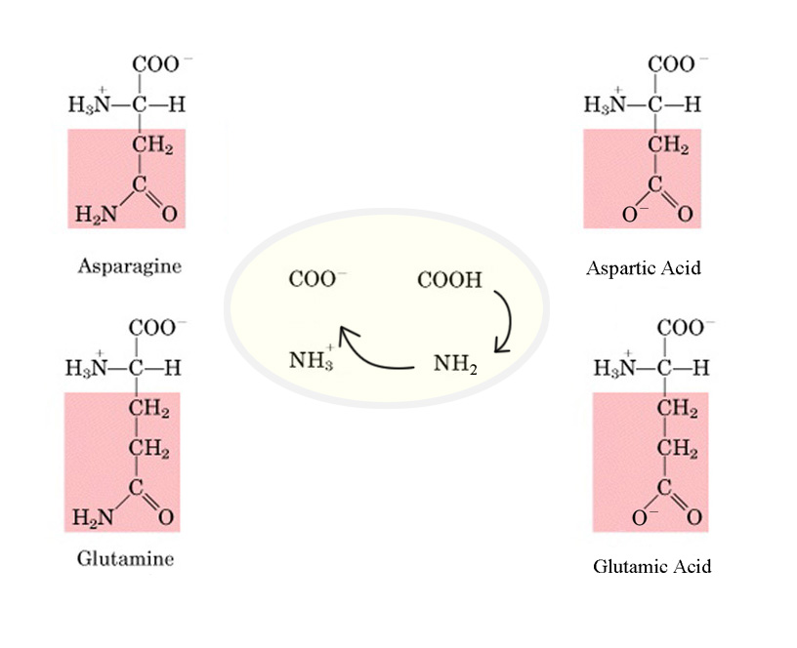
4. Acidic Amino acids:
They are called Acidic Amino Acids. Why?
Because they contain a Carboxylic group.

Slide 14
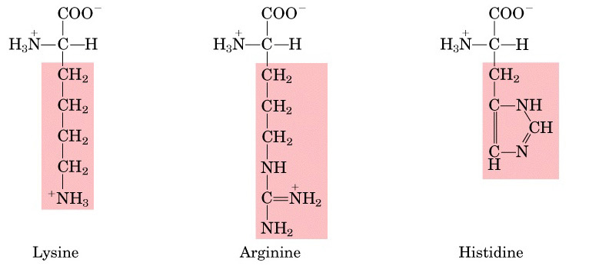
5. Basic Amino Acids:
Histidine has higher polarity.
All Basic amino acids contain 6 carbon atoms.

Slide 15
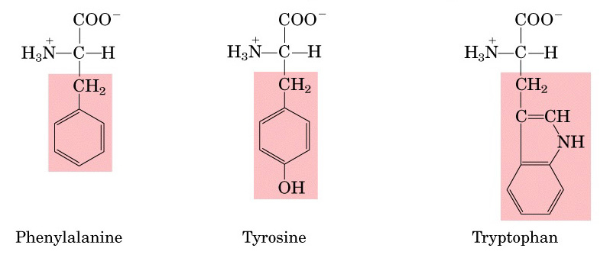
6. Aromatic Amino Acids:
Tyrosine is also included in group No.2
Because it contains OH group.

Slide 16
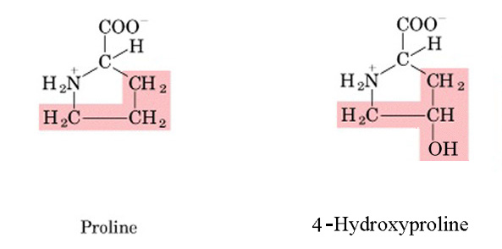
7. Imino Acids:
Imino Acids contain NH rather than NH2.

Slide 17
Notes:
Carbon in Amino Acids is chiral except in Glycine.
Only L α -Amino Acids occur in protein.
The α -R group determine the properties of amino
acids.
Functional groups (SH), (OH) determine the reactions
of amino acids.

